Slide 1

7th Grade Math
Unit 4, Lesson 3 Finding the Area of Polygons Volume 1, pg. 136

Slide 2


Benchmark
MA.7.GR.1.2
Solve mathematical or real–world problems involving the area of polygons or composite figures by decomposing them into triangles or quadrilaterals.
volume 1, pg. 136

Slide 3
Integrated Mathematical Thinking and Reasoning Standards
MA.K12.MTR.1.1 Actively participate in effortful learning both individually and collectively.
MA.K12.MTR.2.1 Demonstrate understanding by representing problems in multiple ways.
MA.K12.MTR.4.1 Engage in discussions that reflect on the mathematical thinking of self and others.
MA.K12.MTR.5.1 Use patterns and structure to help understand and connect mathematical concepts.
volume 1, pg. 136

Slide 4

Learning Targets
I can decompose a regular polygon into triangles to find the area.
I can decompose a regular polygon into triangles and quadrilaterals to find the area.
volume 1, pg. 136

Slide 5

Warm-Up
volume 1, pg. 137

Slide 6
4.3.1 Warm-Up: Which One?
The dimensions of two rectangles are given.
Rectangle A 13 units by 15 units |  | Rectangle B 2 units by 3 units
Explain which rectangle is more like a square.
volume 1, pg. 137
Notes:
Video Link: https://algebranation.wistia.com/medias/fi4fidi5y8

Slide 7

Guided Instruction
volume 1, pg. 137

Slide 8



4.3.2 Guided Instruction: Decomposing Regular Polygons
A regular polygon is a polygon that is both equilateral (all sides congruent) and equiangular (all angles congruent).
A regular octagon is shown.
On the figure, mark all congruent angles and all congruent sides.
Draw lines to decompose the regular octagon into congruent triangles.
volume 1, pg. 137

Slide 9
How many congruent triangles did you decompose the regular octagon into?
Discuss with your partner how decomposing the octagon into congruent triangles is helpful in determining the area.
volume 1, pg. 137

Slide 10
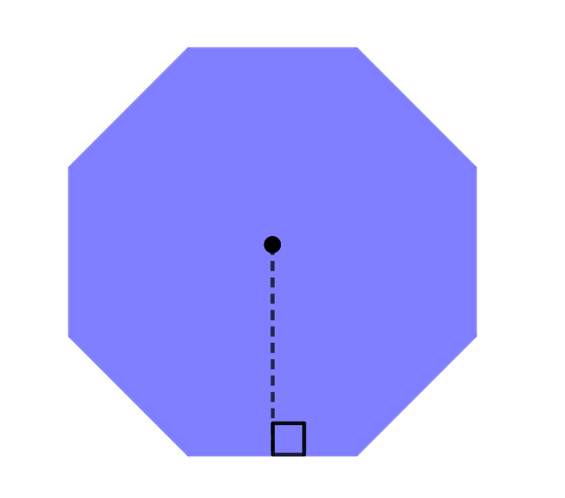


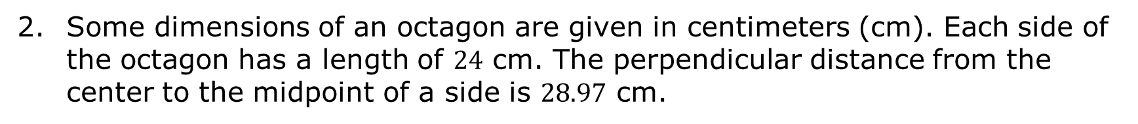
Some dimensions of an octagon are given in centimeters (cm). Each side of the octagon has a length of $24$ cm. The perpendicular distance from the center to the midpoint of a side is $28.97$ cm.
Find the area of one decomposed triangle. Round your answer to the nearest thousandth.
Find the area of the regular octagon rounded to the nearest thousandth of a square centimeter (cm²) by finding the sum of the areas of all the decomposed triangles.
$28.97$ cm
$24$ cm
volume 1, pg. 138

Slide 11
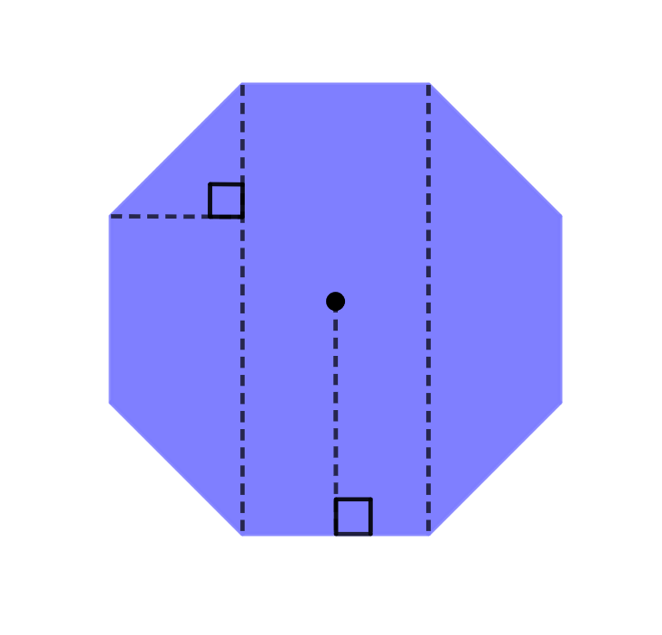
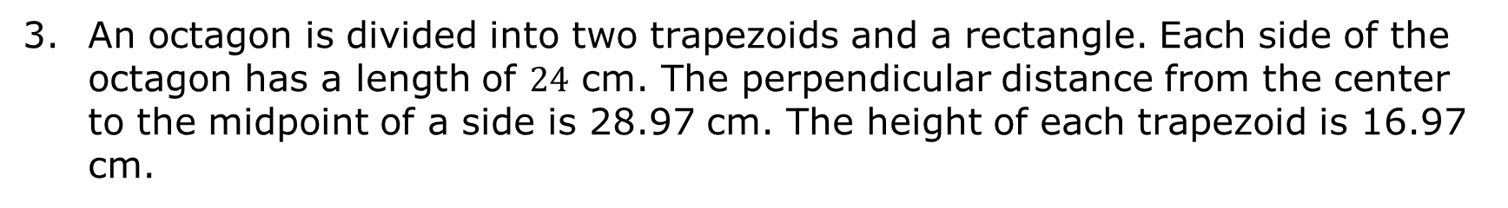



An octagon is divided into two trapezoids and a rectangle. Each side of the octagon has a length of $24$ cm. The perpendicular distance from the center to the midpoint of a side is 28.97 cm. The height of each trapezoid is 16.97 cm.
Find the area of each decomposed quadrilateral. Round to the nearest hundredth.
Using the decomposed shapes, determine the area of the octagon rounded to the nearest thousandth of a square centimeter (cm²).
$16.97$ cm
$28.97$ cm
$24$cm
volume 1, pg. 138

Slide 12
Complete the chart using the areas from question 2b and 3b.
Decomposition | Area of Octagon
triangles
quadrilaterals
What do you notice about the areas?
volume 1, pg. 139

Slide 13

Collaboration
volume 1, pg. 139

Slide 14


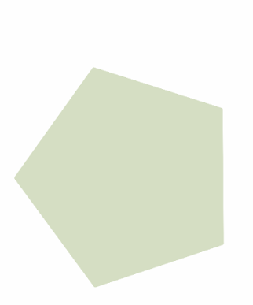
4.3.3 Collaboration: Decomposing Regular Polygons to Find Area
Decompose each of the following regular polygons.
volume 1, pg. 139

Slide 15


Share with your partner how you decomposed your shapes. If your partner decomposed the shapes differently, draw on the blue shapes how they decomposed their shapes. If you decomposed the shapes in the same way, work together to create a different way to decompose the shapes.
volume 1, pg. 139

Slide 16
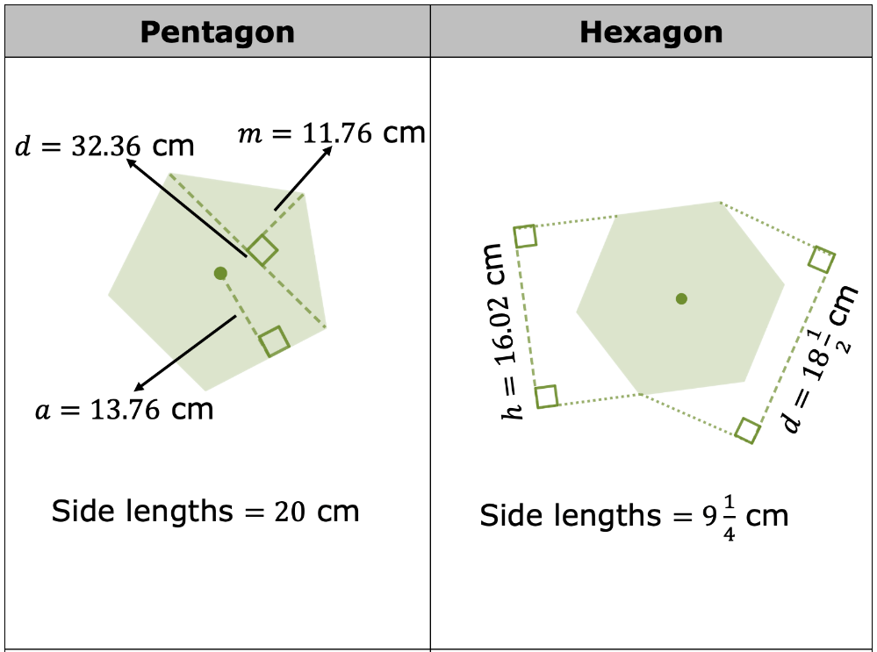
The table shows a pentagon and a hexagon. Given measurements in centimeters (cm). Work with your partner to determine the area rounded to the nearest hundredth.
volume 1, pg. 140

Slide 17
Area of Pentagon | Area of Hexagon
volume 1, pg. 140

Slide 18

Your Turn
volume 1, pg. 140

Slide 19
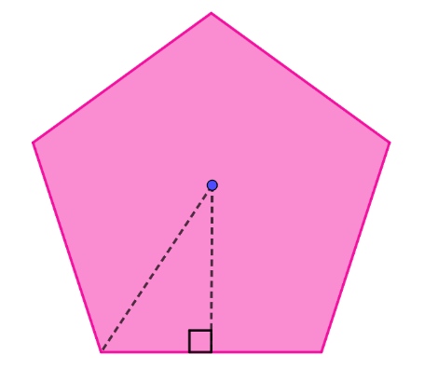
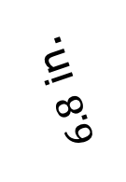
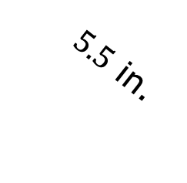

4.3.4 Your Turn!
A regular pentagon is shown with lengths in inches (in.).
$8$ in.
$5.5$ in.
$6.8$ in.
What is the area of the pentagon?
volume 1, pg. 140

Slide 20
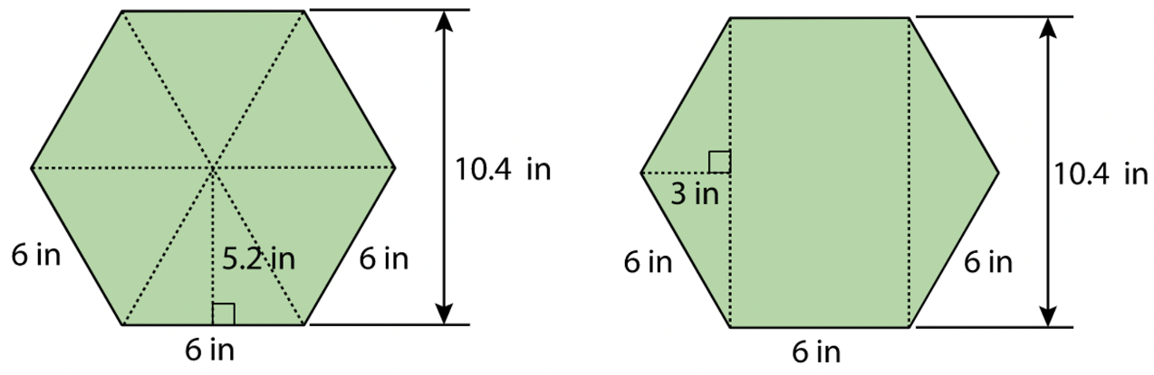
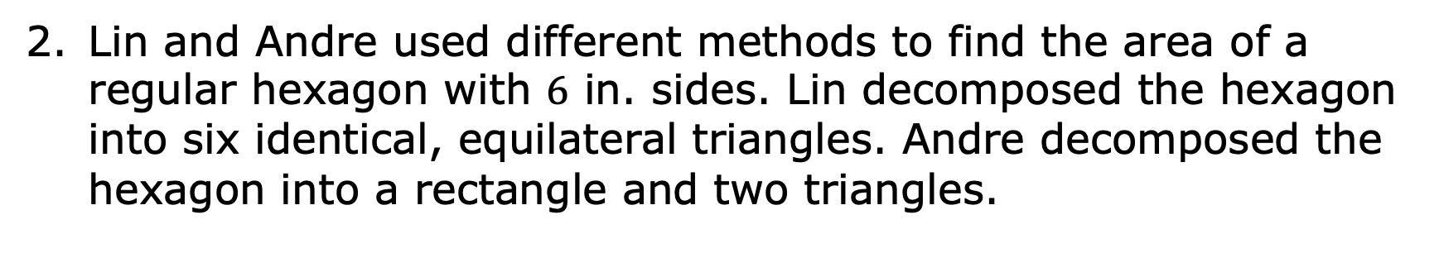
Lin and Andre used different methods to find the area of a regular hexagon with $6$ in. sides. Lin decomposed the hexagon into six identical, equilateral triangles. Andre decomposed the hexagon into a rectangle and two triangles.
volume 1, pg. 141

Slide 21
Explain why Lin and Andrea will find the same area of the hexagon.
Find the area of the hexagon using both Lin’s and Andre’s methods.
Lin’s Method | Andre’s Method
volume 1, pg. 141

Slide 22
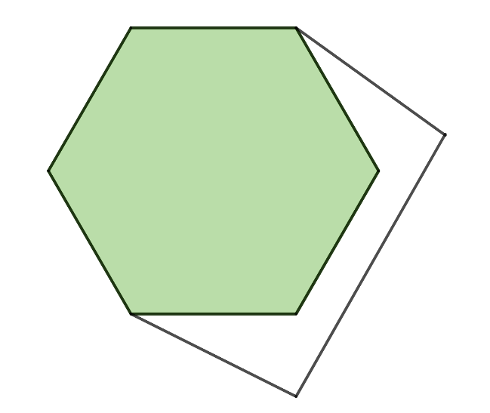
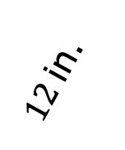
Decompose the shape differently than Lin and Andre did.
$12$ in.
Using the measurements given in all three figures, find the area by finding the sum of your decomposed parts.
volume 1, pg. 141

Slide 23

Wrap-Up
volume 1, pg. 142

Slide 24
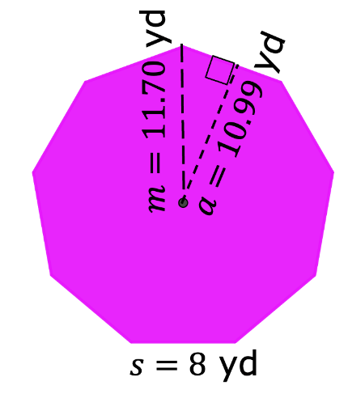
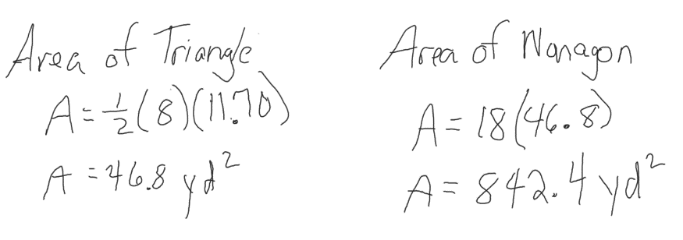
4.3.5 Wrap-Up: Error Analysis
Vernon found the area of the nonagon. His work is shown.
Explain to Vernon what error(s) he made in his work.
What is the area of the nonagon?
Vernon’s Work
volume 1, pg. 142

